Slide 1
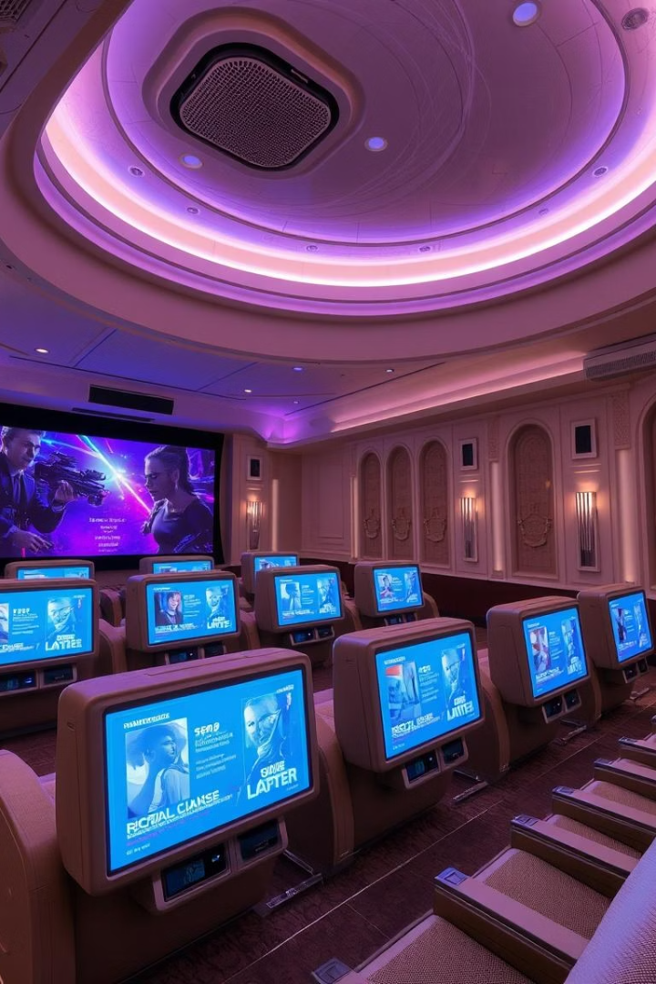
AI-Based Movie Recommendation System
This system recommends movies to users. It leverages AI and machine learning models. This enhances user experience and engagement.

Slide 2




Tools and Technologies
Python
Scikit-learn
Pandas
Flask
Primary programming language.
Building machine learning models.
Efficient data handling.
Creates web interface.
Our system uses Python for core development. Scikit-learn builds models like Cosine Similarity. Pandas ensures efficient data handling. Flask creates the interactive web interface. TMDb API is optional for rich details.

Slide 3
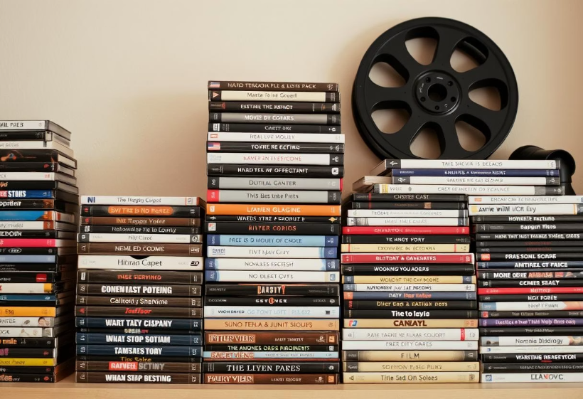
Dataset Collection
MovieLens Dataset
The MovieLens dataset is a popular choice for developing recommendation systems. It includes movie titles, genres, and user ratings. Available in different sizes, it can be tailored to fit your project's requirements. The dataset is free, publicly accessible, and widely trusted in the community.
Notes:
The MovieLens dataset is a widely used resource for developing and testing movie recommendation systems. It contains movie titles, genres, and user ratings, which provides a rich dataset for this type of project. The dataset comes in different sizes, allowing you to choose the one that best fits your project needs. Using a publicly available dataset like MovieLens can save time and effort compared to collecting your own data from scratch. The dataset is free and easy to access, making it a convenient choice for this type of project.

Slide 4


Data Preprocessing
Cleaning
Handle missing values. Resolve inconsistencies. Ensure data quality.
Combine Features
Integrate movie title and genre. Essential for content-based filtering.
Data preprocessing ensures high-quality input. It involves cleaning and combining features. Feature engineering creates effective representations.

Slide 5

Model Building
Collaborative Filtering
Predicts preferences based on similar users or items.
Content-Based Filtering
Recommends movies similar to user's liked content.
Hybrid Approach
Combines collaborative and content-based methods for better results.

Slide 6
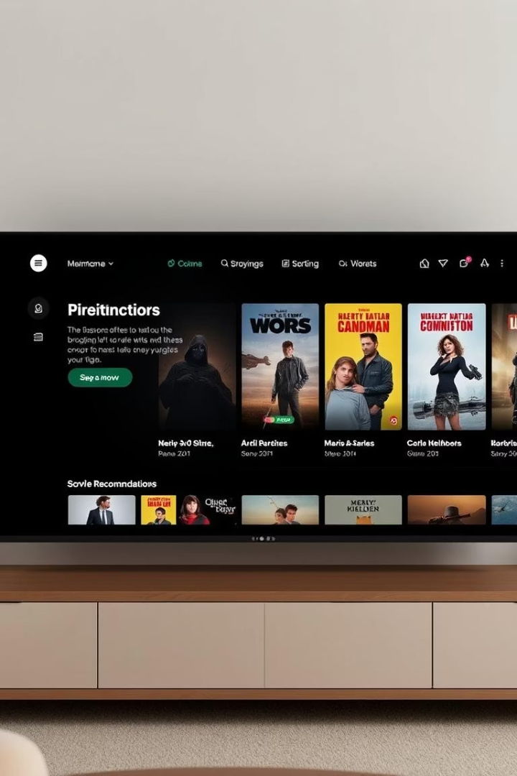
Web Interface
Flask Framework
Chosen for its lightweight nature. It simplifies web development.
User-Friendly Design
Allows easy preference input. Displays recommendations clearly.
Interactive Experience
Enables seamless user interaction. Enhances the overall recommendation process.
Flask is used to build the web interface. It creates a simple, intuitive user experience. Users can easily input preferences and view suggestions.

Slide 7




Recommendation Process
AI Model Generation
User Input
AI model generates movie recommendations.
Users enter their preferences.
Data Processing
Display Recommendations
System processes input data.
Recommendations are shown via web interface.
The process begins with user input. Data is processed by the system. The AI model generates recommendations. These are then displayed on the web interface. TMDb API integration fetches rich movie details.

Slide 8

Conclusion
Developed System
Personalized Suggestions
Successfully created an AI-based movie recommendation system.
Machine learning personalizes movie recommendations effectively.
Future Potential
Ready for deployment and continuous enhancement.
We have developed an AI-based movie recommendation system. It uses machine learning for personalized suggestions. Future enhancements include incorporating user feedback and expanding the dataset.

